Slide 1

HACKSTREET 3.O
Hackathon
TEAM:
NHCE AI
Member 1: N Manish
Member 2: B N Lohith Kumar

Slide 2


TEAM PROFILE
Member 1:
Skill: Machine Learning
Role: Dataset Creation and Model Training
Member 2:
Skill: Machine Learning and Designing
Role: Data Collection and UI Design

Slide 3
AI-BASED SMART SEED PLANTING DEPTH PREDICTION SYSTEM
Optimizing Seed Planting Depth Based on Real-time Soil and Weather Data
“Harnessing AI to Grow Smarter, With Optimal Seed Planting Depth Predictions”
Theme: Environment

Slide 4
PROJECT SUMMARY
The AI-based Smart Seed Planting Depth Prediction System uses real-time soil and weather data to provide farmers with optimal seed planting depth recommendations tailored to different crops such as wheat, corn, and rice. By analyzing crucial factors like soil type, moisture levels, temperature, and humidity, the system employs AI algorithms to predict the ideal planting depth, ensuring healthier plant growth and improved crop yields. This innovative solution promotes sustainable farming practices by empowering farmers to make informed, data-driven decisions, reducing resource wastage like water and energy, enhancing crop productivity, and contributing to environmentally-conscious agricultural practices.

Slide 5


PROBLEM STATEMENT
The problem statement for this project revolves around the challenges faced by farmers in determining the optimal seed planting depth, which directly impacts crop growth and yield. Currently, planting depth is often based on experience or generalized guidelines, ignoring real-time environmental factors like soil type, moisture levels, temperature, and humidity. This lack of precision leads to inefficiencies, such as overuse of water and energy, poor seed germination, and lower crop productivity. The goal is to address these challenges by leveraging AI to provide data-driven, personalized planting depth recommendations, improving agricultural sustainability and resource management.

Slide 6
SOLUTION
The AI-based Smart Seed Planting Depth Prediction System is an innovative solution that uses real-time soil and weather data to recommend the optimal planting depth for various seed types like wheat, corn, and rice. By integrating key data such as soil type, moisture, temperature, and humidity, the system applies machine learning algorithms to predict the ideal depth for each crop, ensuring better seed germination, growth, and higher yields. This approach minimizes resource wastage like water and energy, empowering farmers to make informed decisions that improve crop productivity, reduce environmental impact, and promote sustainable farming practices. It ultimately contributes to more efficient farming and healthier ecosystems.

Slide 7

TARGET AUDIENCE
The target audience for the AI-based Smart Seed Planting Depth Prediction System includes farmers, agricultural experts, and agritech innovators who seek to optimize crop production through data-driven insights. This system supports sustainability-focused organizations looking to reduce water and energy usage in farming while enhancing productivity. It also benefits those in precision agriculture, offering a tailored approach to planting crops like wheat, corn, and rice.
Additionally, the system is relevant for researchers in agriculture, environmental science, and forestry working on afforestation and sustainable land management. Government bodies and NGOs focused on reforestation and sustainable farming can use this technology to make informed planting decisions, promoting healthier ecosystems and better forest management.

Slide 8
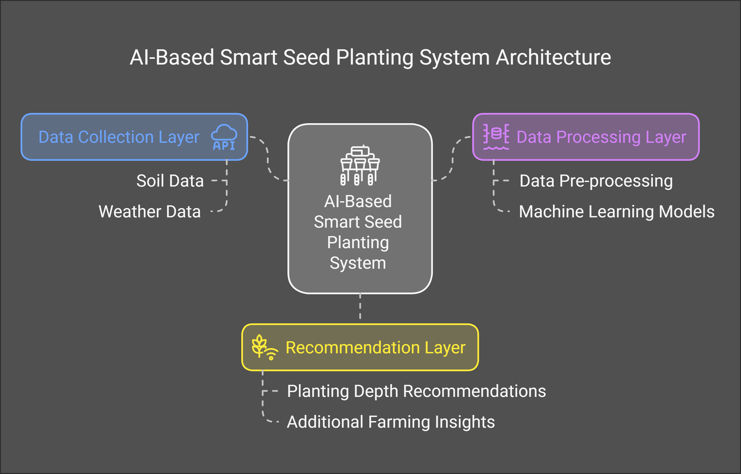
OVERVIEW OF OUR
TECHNICAL ARCHITECTURE

Slide 9

THANK YOU

